Slide 1


AI for Everyone

Slide 2

Notes:
This is Samantha, she is the personal assistant for Theodore. She sorts his mail, set ups meetings, and orders groceries. She paints and writes poetry. She is the best friend. And she is also an artificial intelligence from the movie “Her”. Just imagine her as the evolution of Siri.
We’ve all heard about AI, Machine Learning, deep learning, neural networks and natural language processing. It’s time to get to understand the basic concepts of it, and how they’re interconnected.

Slide 3
General or Strong AI
Supervised Learning
Artificial Intelligence (AI)
Narrow or Weak AI
Machine Learning
Artificial Neural Networks
Algorithms
Unsupervised Learning
Deep Learning
Notes:
This is a general diagram of the Interrelation all this terms have.

Slide 4
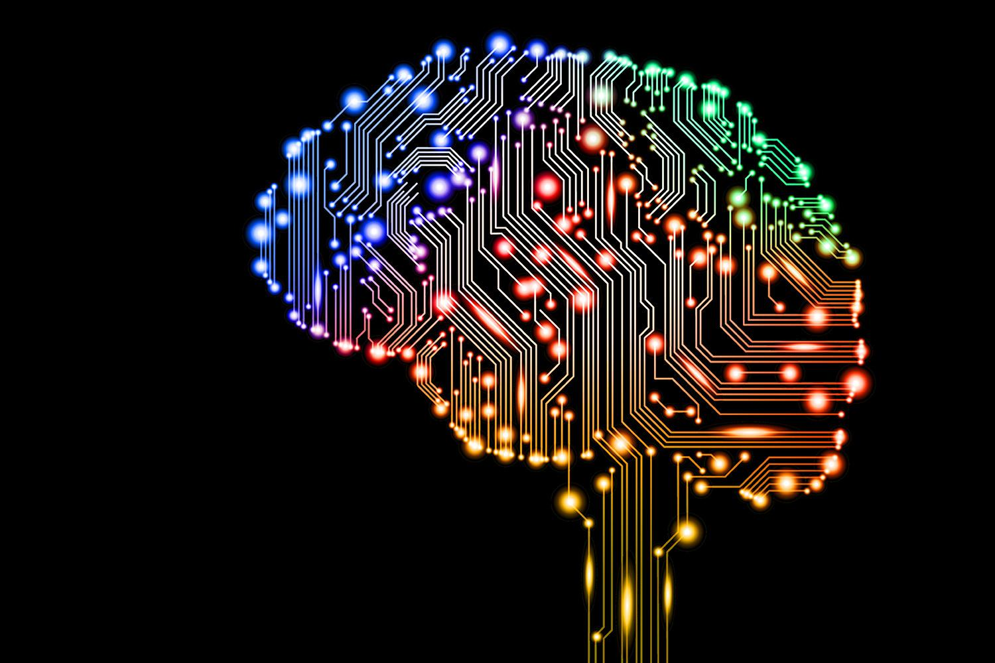
What is AI?
It’s an attempt to make computers smart, or even smarter than human-beings.
It’s about giving computers human-like behaviours, thought process and reasoning abilities.

Slide 5

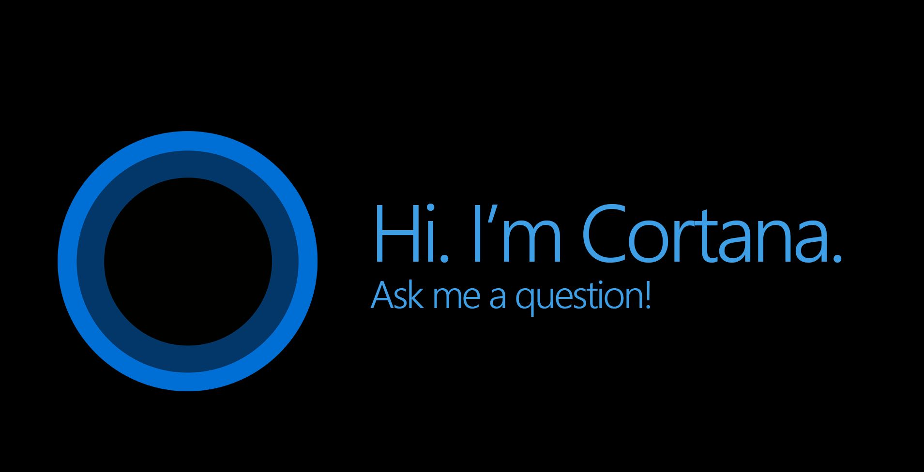
Narrow or Weak AI
That’s the AI that is focused on a narrow task. Siri and Cortana are great examples of this AI, they are giving us the weather, but they have limits.
Siri can’t read and delete your unimportant emails.It can’t go beyond its original programming.

Slide 6

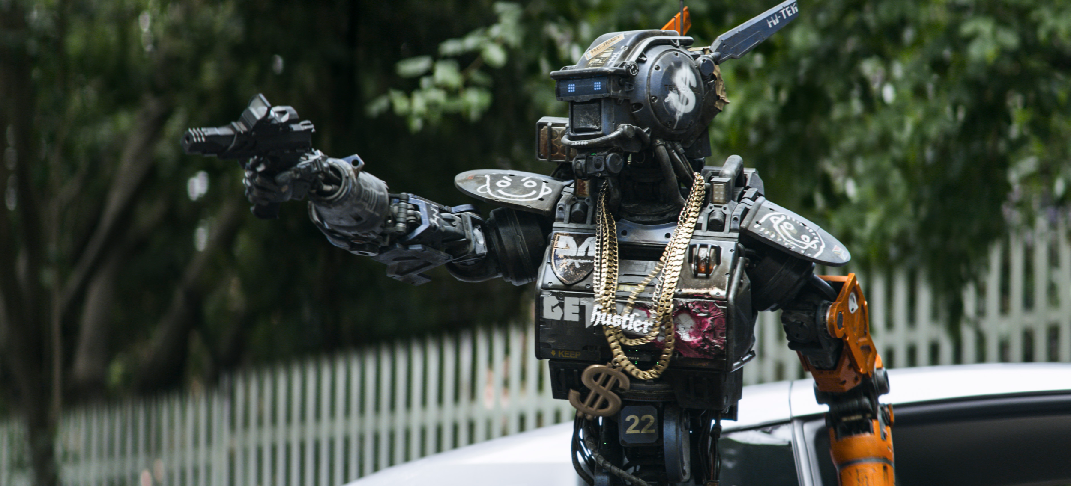
Strong or General AI
This is what we have seen in science fiction.
Samantha is the very definition of strong AI. She can learn new things and modify her own code base.
She can beat you in chess and drive a car.

Slide 7
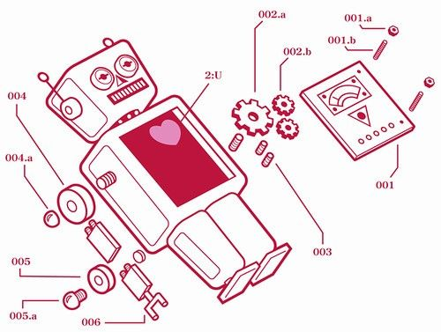
The Anatomy of AI
Perception
Natural Language Processing
Knowledge Representation
Reasoning
Planning and Navigation

Slide 8
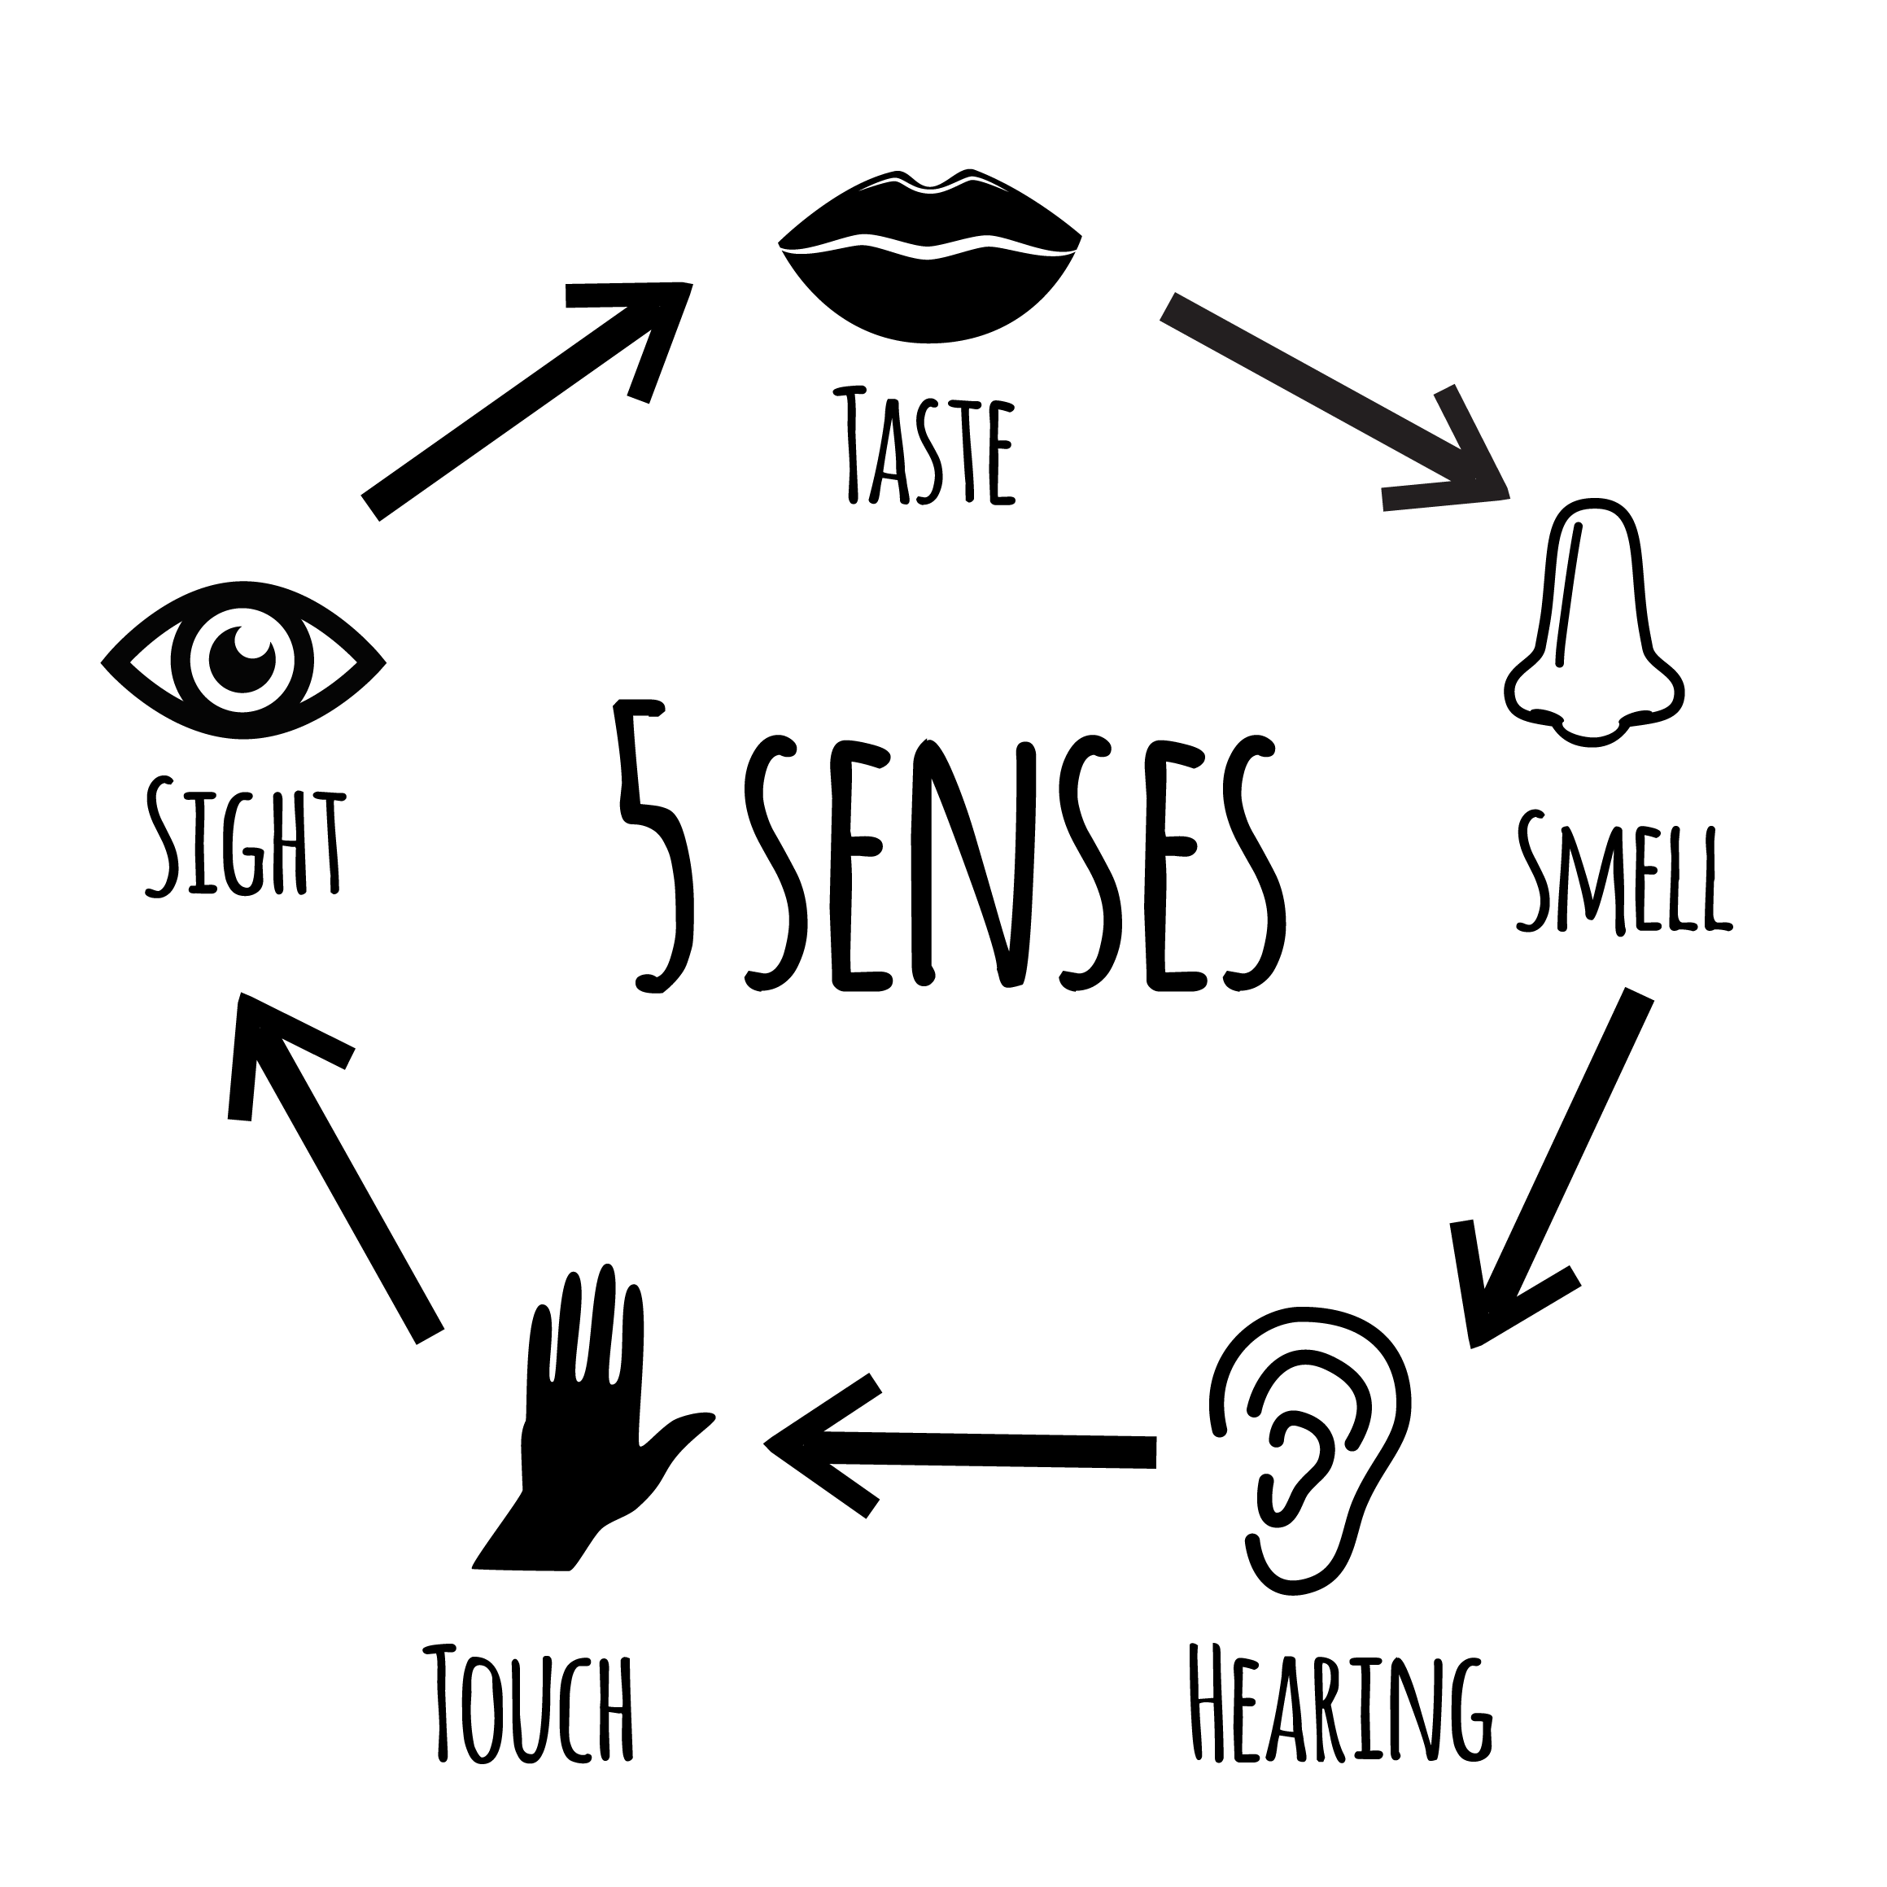
Perception
Computers needs senses in order to perceive, and can have more than human’s five, like X-ray vision or Sonar detection.

Slide 9
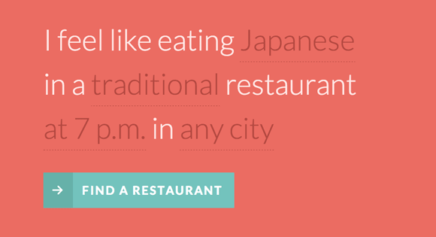
Natural Language Processing
That’s a hard task for computers in both spoken and written language, given how the same sentence can have different meanings depending on the context.

Slide 10
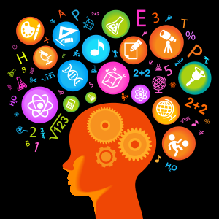
Knowledge Representation
Now that the computer can perceive, and understand Language, it needs its own way to represent that in its own “mind”.

Slide 11
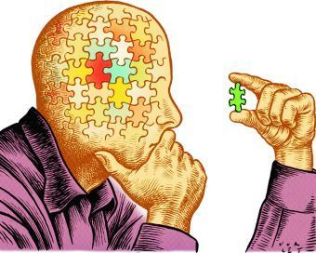
Reasoning
Now that it collected all the data via it senses and it was able to connect all the information together, this data can be used to solve problems logically.

Slide 12

Planning and Navigation
AI’s will navigate the three-dimensional world and should plan the optimal route.

Slide 13
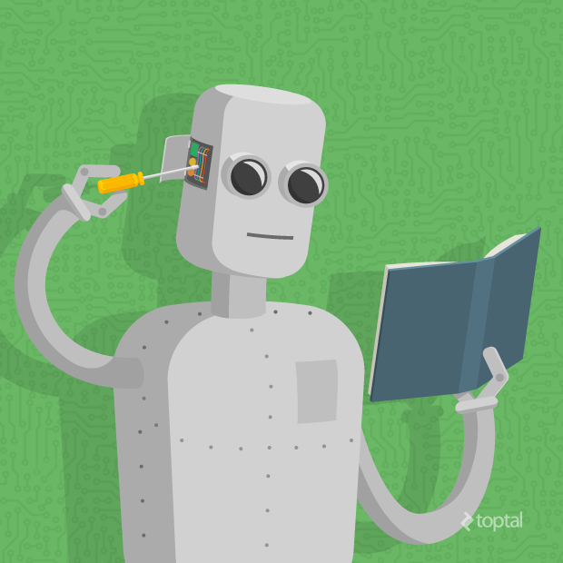
Machine Learning
That’s an AI technique concerned with learning insights from data and using them to make predictions about the world.
Machine Learning is done with Algorithms.

Slide 14
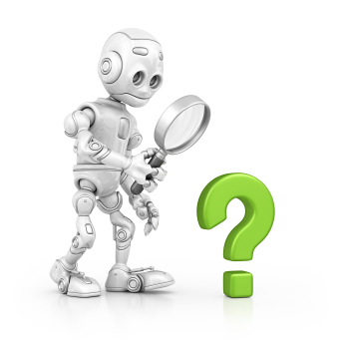
Unsupervised Learning
This kind of learning is when you let the algorithm find the right answer categorizing the data. No examples of right answers are provided.

Slide 15

Supervised Learning
This kind of learning is when you guide the Algorithm to the right answer by providing examples.

Slide 16

Algorithms
An algorithm is a serious of steps to accomplish a task.
The machine learning algorithm that’s setting the world ablaze, however, is the artificial neural network

Slide 17
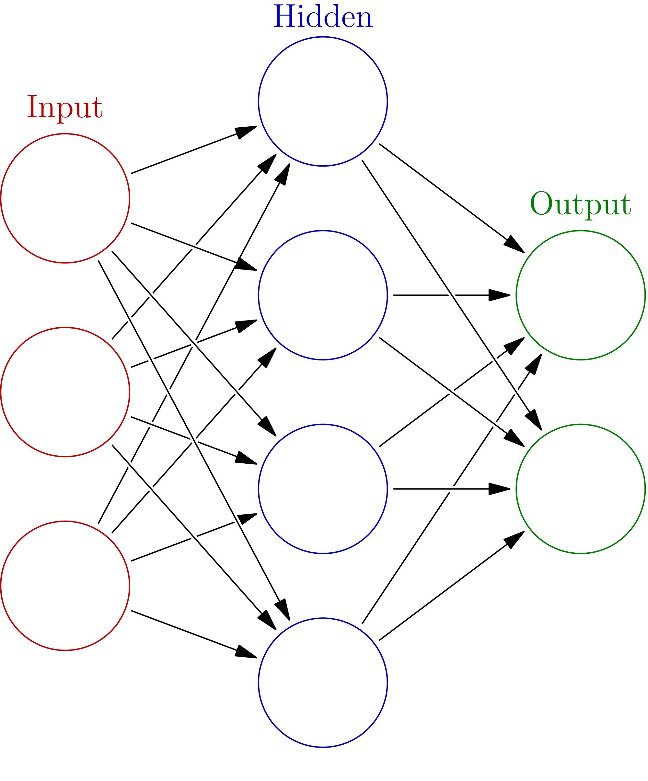
Artificial Neural Network
A technique inspired by how our brain’s neurons work.
This artificial brain can learn how to identify chairs from photos, for example. Over time, it’ll learn what the characteristics of chairs are, and increase its probability of identifying them.

Slide 18
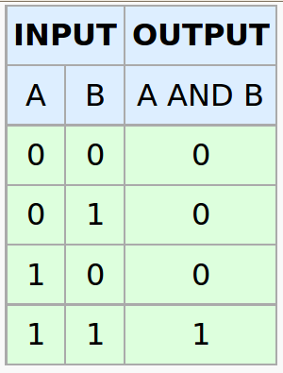

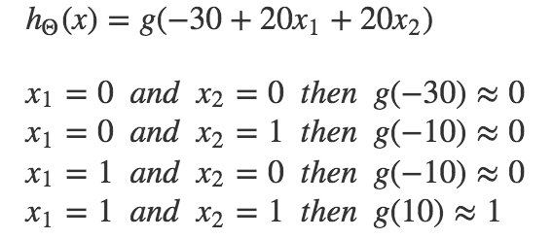
The NN Algorithm

Slide 19
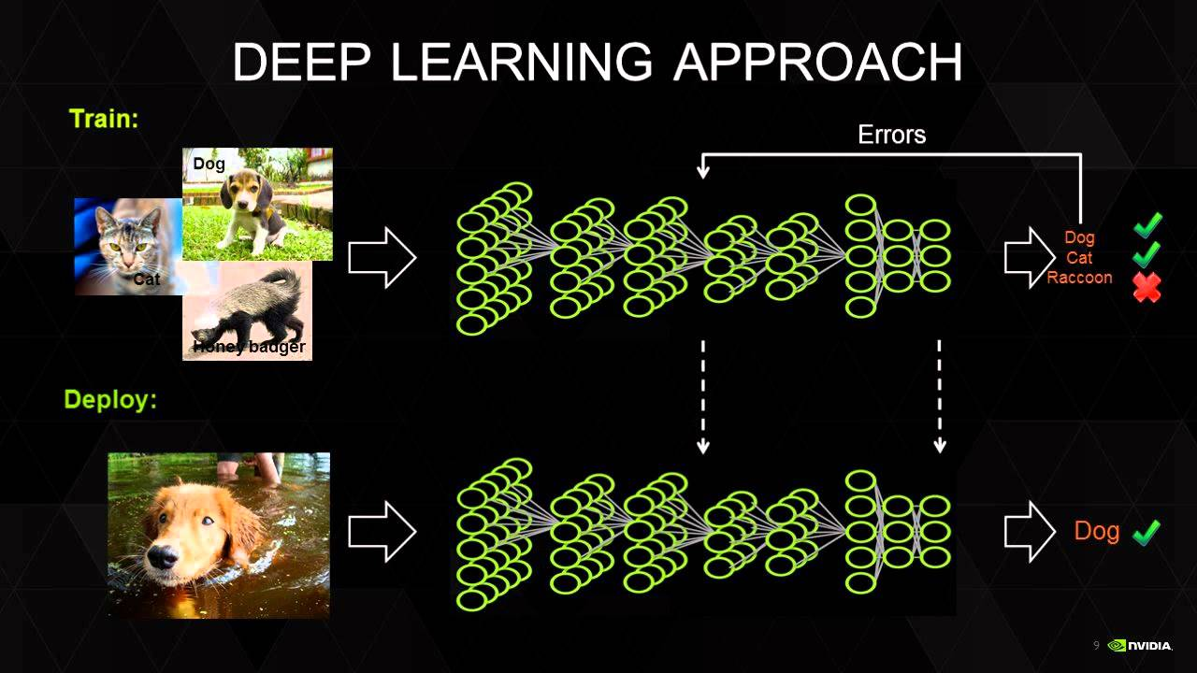
Deep Learning
Is simply a set of methods for training multi-layered artificial neural networks.
Used mostly on finding patterns from data.

Slide 20
General or Strong AI
Supervised Learning
Artificial Intelligence (AI)
Narrow or Weak AI
Machine Learning
Artificial Neural Networks
Algorithms
Unsupervised Learning
Deep Learning
Notes:
This is a general diagram of the Interrelation all this terms have.

Slide 21
Industries using AI
Facebook is using deep learning in M, virtual assistant that help users complete their tasks.
Google is using a deep learning system called RankBrain to filter search results with ambiguous queries.
Kensho AI’s creation Warren, is “The Siri of the financial world”. Similar to the way IBM Watson in programmed.
LeadGenius uses a global network of more than 500 skilled researchers in 40 different countries to train a machine learning system for B2B sales.

Slide 22
More Industries using AI...
Enlitic a San Francisco startup is serious about creating an AI-based medical diagnostics system that can accurately diagnose patients.
X.ai's tool, Amy, schedules meetings for busy professionals.
Legal Robot can help consumers by providing legalese for letters and reviewing contract language.
The Grid puts data to use in helping users create websites that bring results, giving them the information they need to know where to put a particular button or how to set up navigation on a certain type of site.

Slide 23
Advices for applying AI

Slide 24
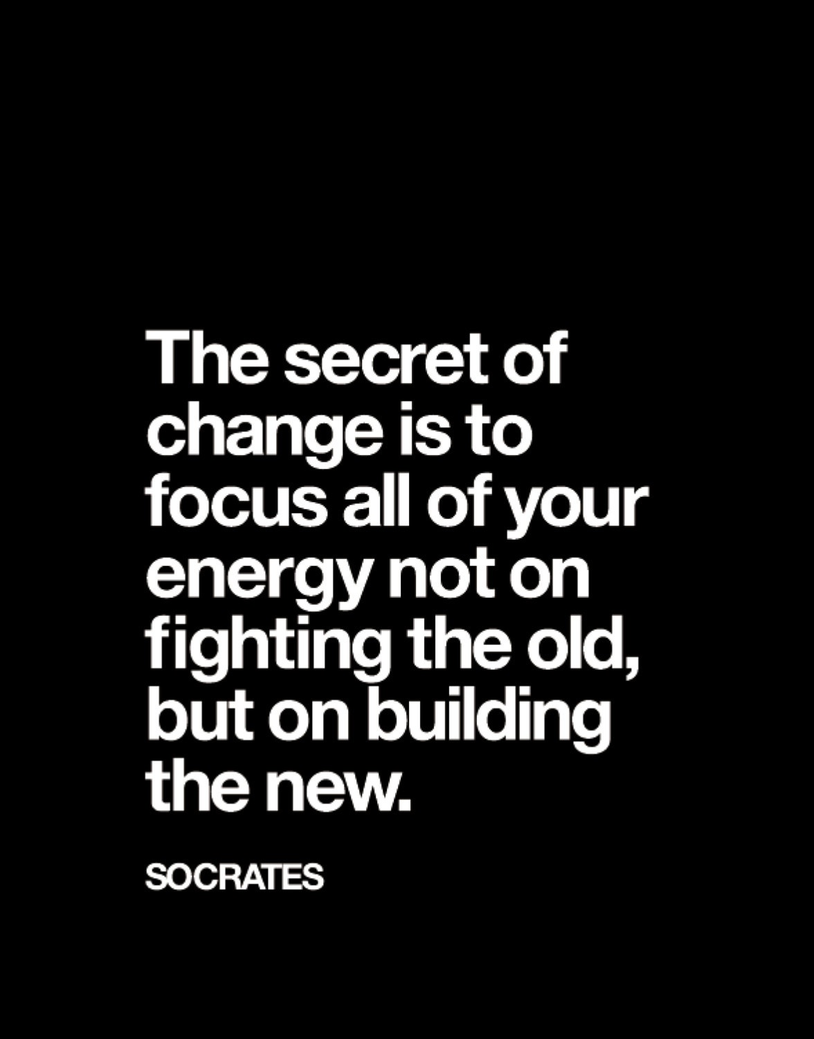
A very own new data set to train ML models
A completely different approach to solve big problems using AI

Slide 25
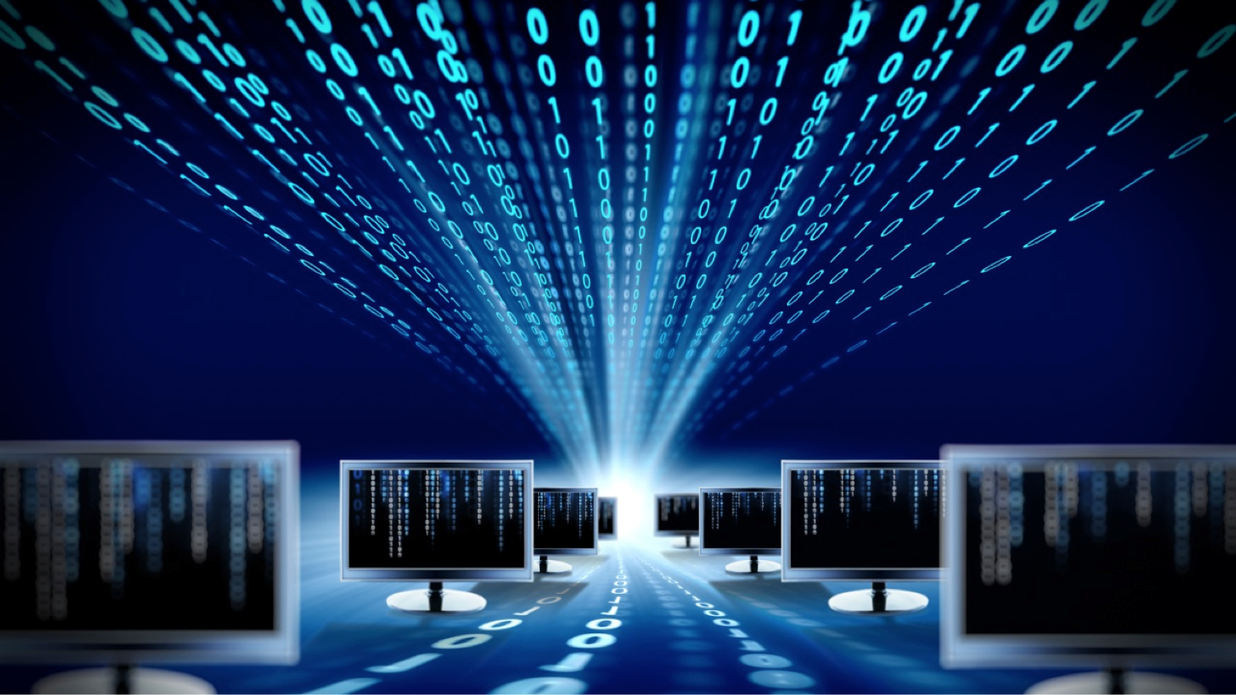
It’s better to have the best data to solve a specific problem or to be playing a different game.

Slide 26

“Data is the fuel”
We feed data for training machine learning models that can create powerful network effects at scale.

Slide 27
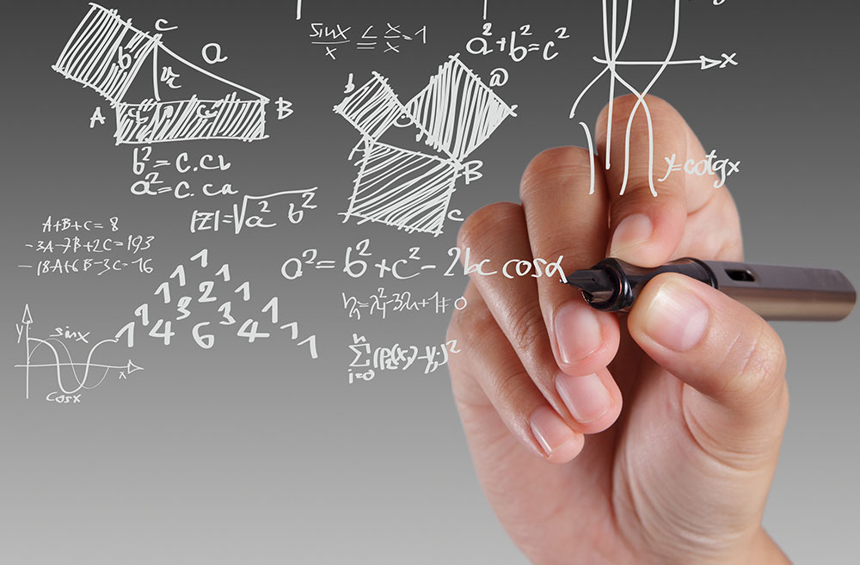
It’s nearly impossible to develop a competitive advantage around algorithm development alone.

Slide 28



Google has built their system around search data and ad clicks.
Facebook their newsfeed and social interaction data.
Amazon their product purchasing and recommendation data.

Slide 29

A very own Data Aggregator perspective
Waze

Slide 30
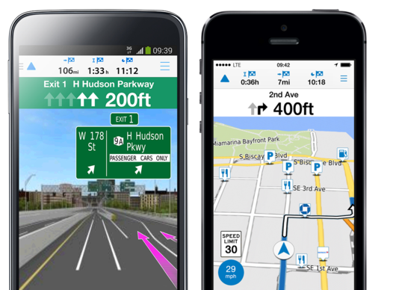
Google could have built the necessary features into google maps, but it would have been tough for them to replicate this data set in a short time and compete.

Slide 31

Does someone else already owns this dataset?
How would it be for somebody to replicate a similar dataset?

Slide 32
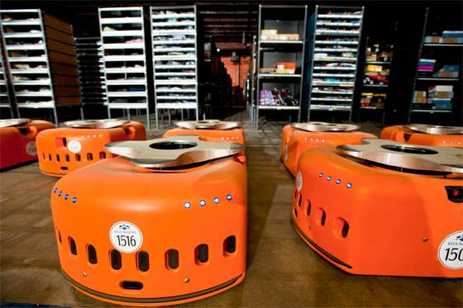
An application pioneer perspective
Kiva Systems
Robots with a focus in warehouse automation
Hardware engineering Automation software Warehouse logistic

Slide 33

Amazon acquired the company in 2012. Operating costs have been cut by 20% where Kiva Systems has been implemented.

Slide 34
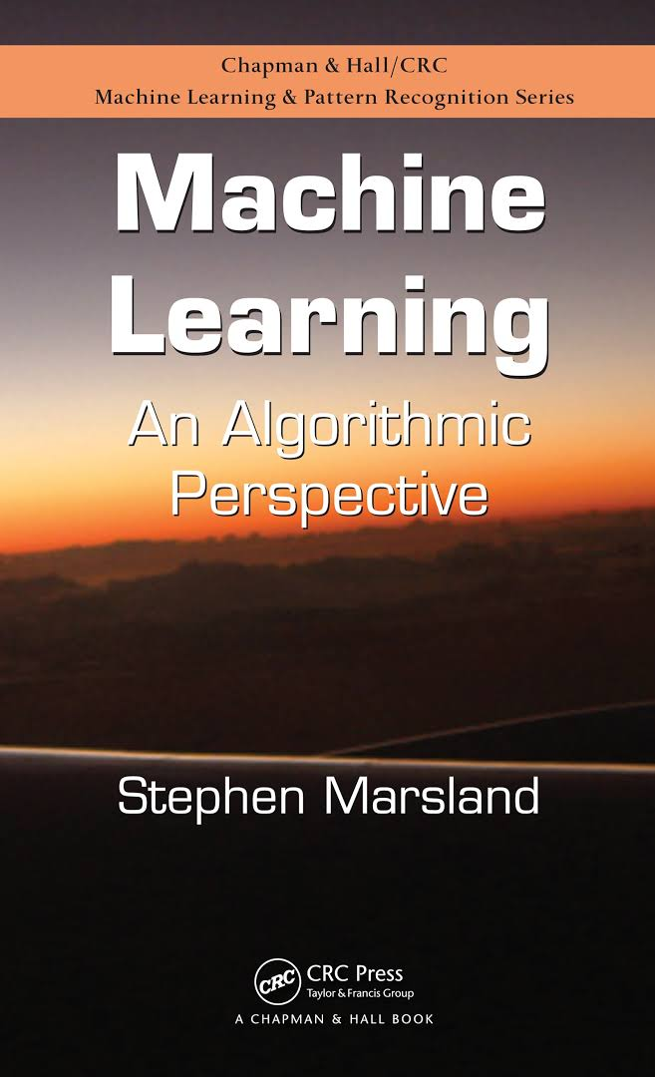
Want to learn more?
Book: Machine Learning An Algorithmic Perspective
By: Stephen Marsland

Slide 35
Want to learn more?
Course: Machine Learning By: Stanford University Hosted by: Coursera
Link: https://www.coursera.org/learn/machine-learning

Slide 36
Want to learn more?
Tools
AzureML By: Microsoft
BigML By: BigML
TensorFlow By: Google
AmazonML By: Amazon

Slide 37
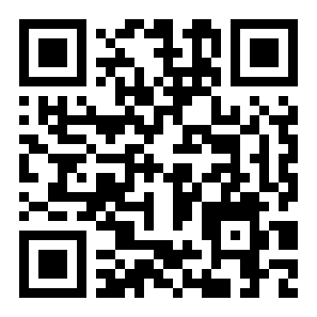
http://bit.ly/2h7oisk hayde@reverscore.com

